Slide 1


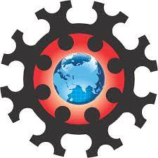
UNIVERSITY INSTITUTE OF ENGINEERING
Academic Unit V
Bachelor of Engineering
(Computer Science & Engineering)
Biology For Engineers
23SZT-148
Meiosis and Mitosis as a part of genetics
Meiosis and Mitosis as a part of genetics
DISCOVER . LEARN . EMPOWER

Slide 2
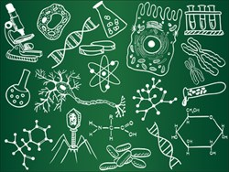
Course Objective
This subject is designed to impart fundamental knowledge on basic and emerging fields of biology like bioinformatics.
It is designed to impart knowledge that how to apply basics of biology in engineering.
https://www.basicknowledge101.com/photos/2016/biology_sketches.jpg

Slide 3
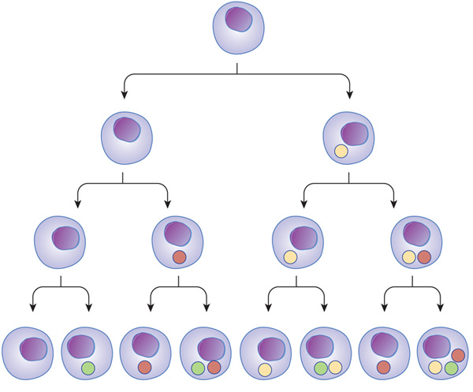
Course Outcome
CO Number | Title | Level
CO1 | To develop the firm foundation in science principles and higher level of understanding in each of the biology sub-discipline. | Remember
CO2 | To excel in career as researcher in both traditional and emerging fields of science . | Understand
CO3 | Understand ethical principles and responsibilities for science practices in society. | Understand
CO4 | To learn the new areas of biology for contemporary research with interdisciplinary approach | Understand
Will be covered in this lecture
https://www.nature.com/scitable/content/ne0000/ne0000/ne0000/ne0000/14707620/U2CP3-4B_RegulProteinsLoop_ksm.jpg

Slide 4
SYLLABUS
Unit-1 | Importance of Biology In Engineering | Contact Hours: 15
Chapter 1 Significance of Biology in Engineering Chapter 2 Genetics | Introduction: Fundamental Differences between Science and engineering by drawing a comparison between eye and camera, Bird flying and aircraft. Significance of Biology in Engineering, Discuss how biological observations of 18th Century that lead to major discoveries, Examples from Brownian motion and the origin of thermodynamics by referring to the original observation of Robert and Julius Mayor. Genetics: Mendel’s laws, Concept of segregation and independent assortment, concept of allele, gene mapping, Gene interaction, Epitasis, Meiosis and Mitosis as a part of genetics. Mechanism of how genetic material passes from parent to offspring. Concepts of recessiveness and dominance. Concept of mapping of phenotype to Genes, single gene disorders in humans, concept of complementation using human genetics.

Slide 5
Cell Cycle and
Cell Division
HOW GENETIC MATERIAL PASSES FROM PARENT TO OFFSPRING

Slide 6
History
When Gregor Mendel began studying heredity in 1843, chromosomes had not yet been observed under a microscope.
Only with better microscopes and techniques during the late 1900s could cell biologists begin to stain and observe subcellular structures, seeing what they did during cell divisions (mitosis and meiosis).
Eventually, some scientists began to study Mendel’s long-ignored work and re-evaluate his model in terms of the behavior of chromosomes.
Around the turn of the 20th century, the biology community started to make the first tentative connections between chromosomes, meiosis, and the inheritance of genes

Slide 7
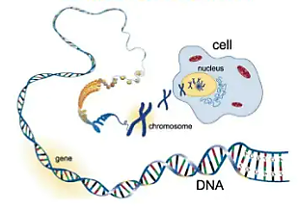

Slide 8
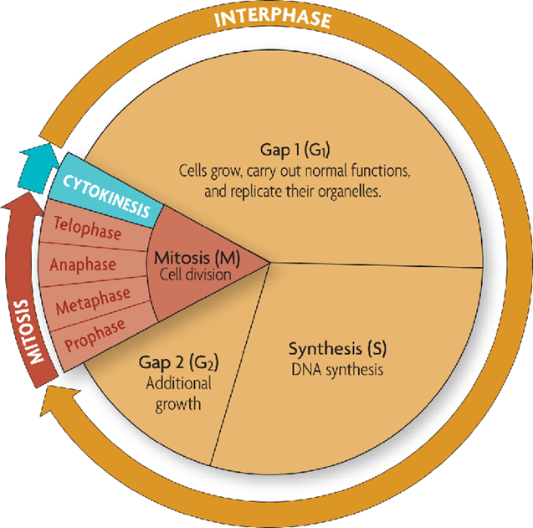
CELL CYCLE
The cell cycle is a regular pattern of growth, DNA replication, and cell division.
The sequence of growth and division of a cell
The cell cycle has four main stages
  G1 (Gap 1): cell growth and normal functions
  S (DNA synthesis): copies DNA
  G2 (Gap 2): additional growth (chromatids become replicated chromosomes)
  M (Mitosis): includes division of the cell

Slide 9
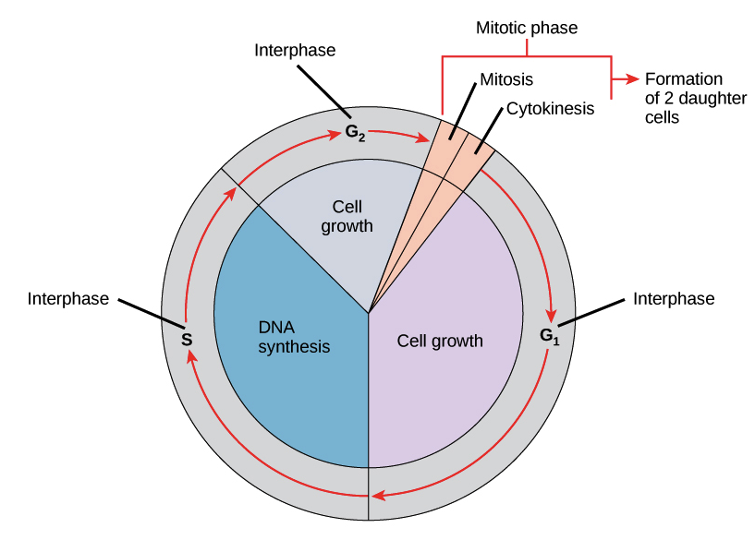
Interphase = G₁, S, G₂
Interphase is when the cell grows, and the organelles double prior to the actual splitting of the nucleus.
93% of a cell’s life is spent in interphase.
Interphase has three parts
  Growth 1 (G₁)
  Synthesis (S)
  Growth 2 (G₂)

Slide 10
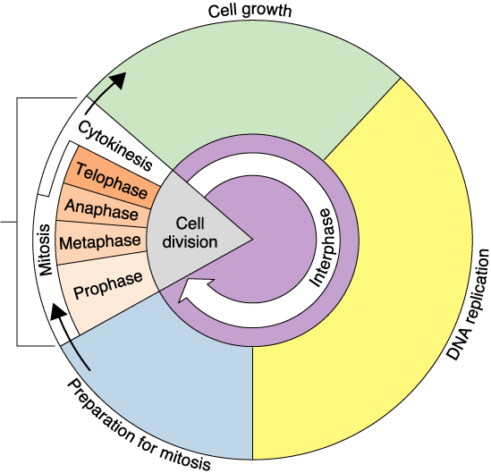
G₁, S, G₂
G₁ is when organelles double.
    Remember each new cell needs a complete set of organelles.
    To continue cell cycle and enter S phase
    Stop cell cycle and enter G0 phase for undergoing differentiation.
    Become arrested in G1 phase hence it may enter G0 phase or re-enter cell cycle.
S when DNA is replicated.
    Each cell needs a complete and identical set of DNA
G₂ Proteins needed for Mitosis are produced
  Followed by the cycle of mitosis and cytokinesis
G₁ phase
S phase
G₂ phase

Slide 11
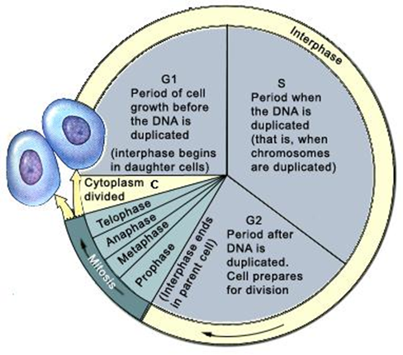
Mitosis
Process that divides cell nucleus to produce two new nuclei each with a complete set of chromosomes
In some Human cells interphases lasts 15.3 hours, while mitosis lasts only 0.7 hours.
Occurs in a series of steps
  Prophase
  Metaphase
  Anaphase
  Telophase
    Cytokinesis
PMAT (Karyokinesis)

Slide 12
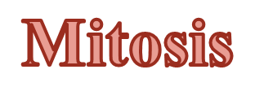
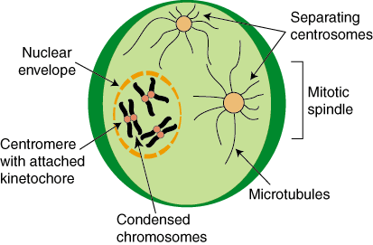
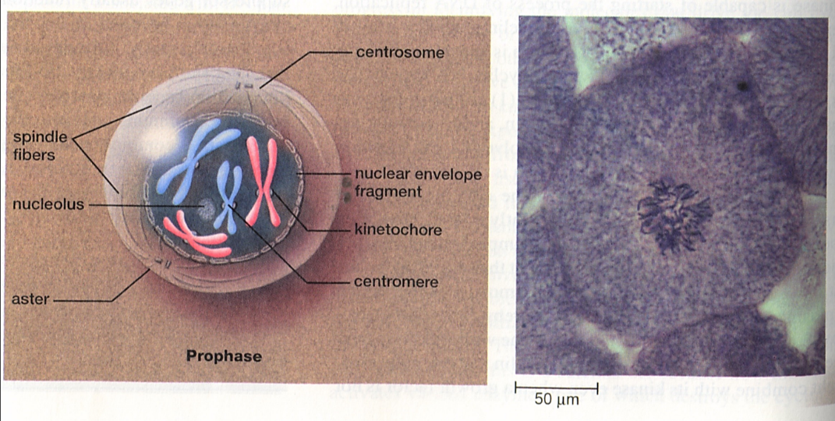
Prophase
Chromosomes now called chromatids because they doubled to form short thick rods which pair up and line up in the center of the nucleus.
A centromere connects the two halves of the doubled chromatids.
Spindle fibers begin to form.
Spindle fiber – a fibrous structure from the cytoplasm which forms to the centriole.
Centrioles move to opposite sides of the cell.
The nuclear membrane breaks down.

Slide 13
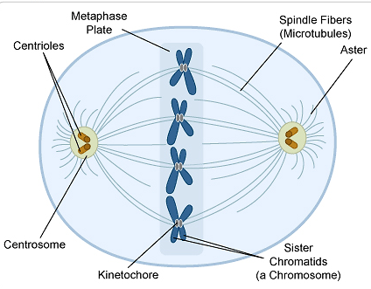
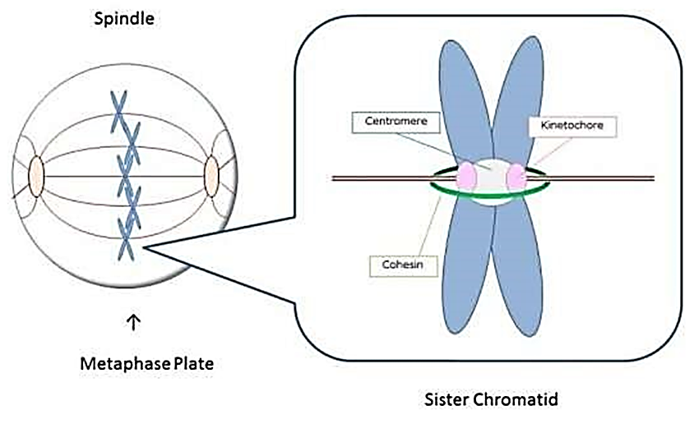
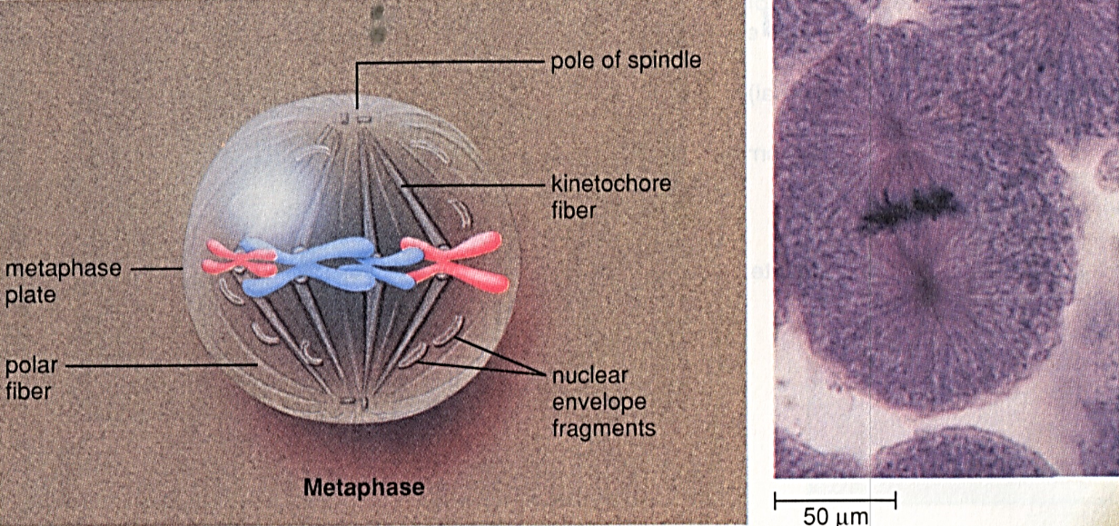
Metaphase
Centromeres of the chromatid pairs line up in the middle of the cell.
Metaphase plate- location where the centromeres line up in the center of the cell.
By the end of metaphase each chromatid has attached to spindle fibers.

Slide 14
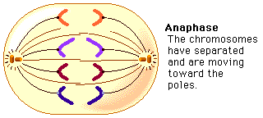
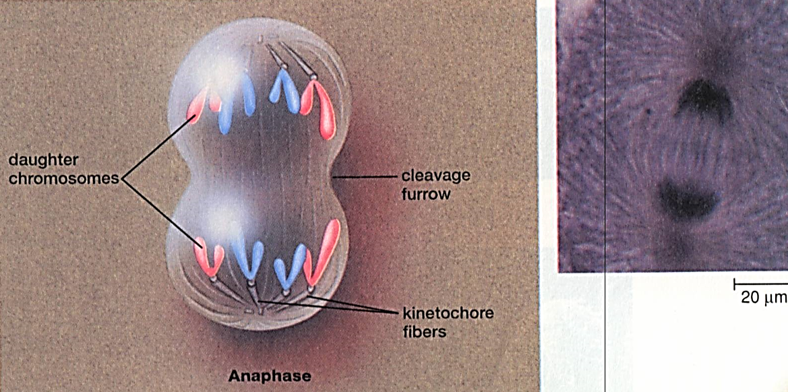
Anaphase
The spindle fibers pull the chromatids apart.
This separates each one from its duplicate.
These move to opposite sides of the cell.
Now there are two identical sets of chromosomes.

Slide 15
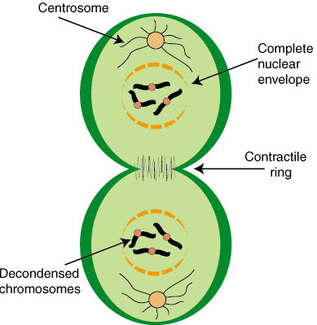
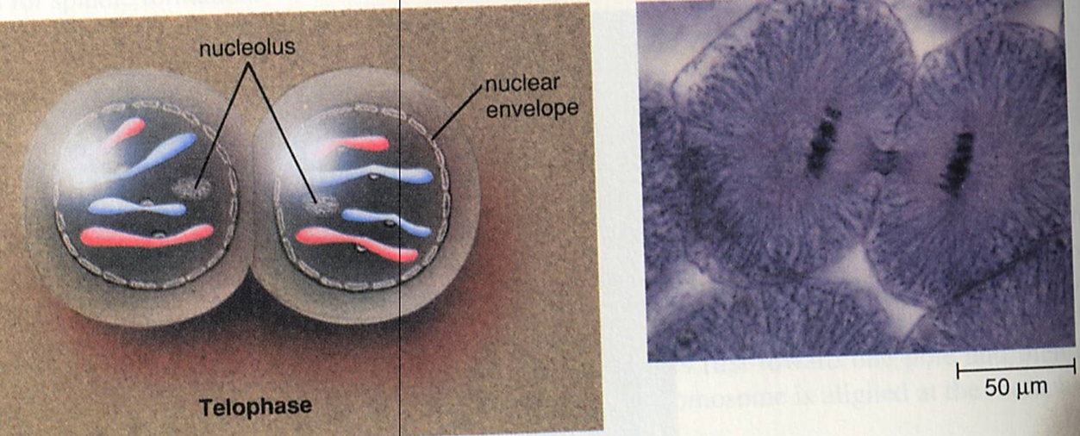
Telophase
When the chromosomes reach opposite sides of the cell the spindle fibers break up.
The nuclear membrane begins to reform.
A furrow begins to develop between the two sets of chromosomes.

Slide 16
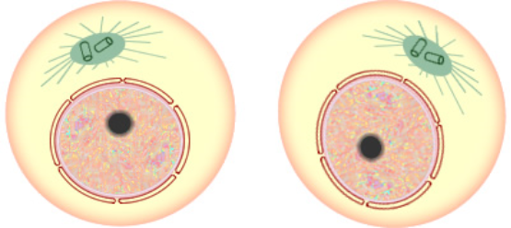
Cytokinesis
The two identical cells completely divide and the cell membrane is completely formed.
Occurs at end of Mitosis
  Division of the cytoplasm to form 2 new daughter cells
  Organelles are divided
  Daughter cells are genetically identical

Slide 17

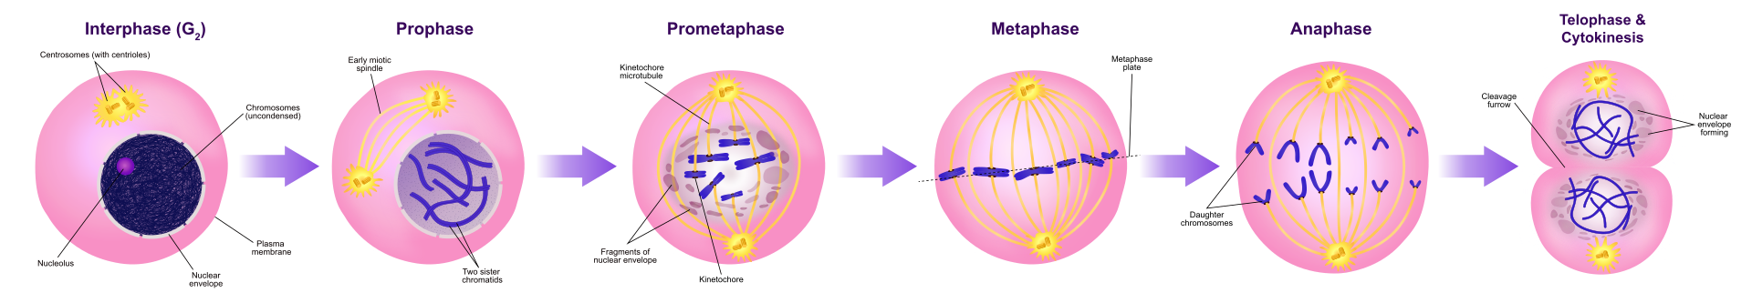
MITOSIS

Slide 18
Significance of Cell Division
WHY CELL DIVISION REQUIRED?
  Cell growth
  Repair & replacement of damaged cell parts or old cells
    In like manner, red blood cells have a short lifespan (only about 4 months) and new RBCs are formed by mitosis
  Reproduction of the species
Cell division is the process by which a parent cell divides into two or more daughter cells.
It is of two type:
  Mitosis- Division take place in somatic cells
  Meiosis- Division take place in reproductive cell

Slide 19
Meiosis
Meiosis is a double division which occurs in a diploid cell and give rise to four haploid cells each having half the number of chromosomes as compared to the parent cells.
Meiotic cell division occurs in germ cells of all eukaryotic organisms.
In sexual reproduction two gametes fuse to give rise to new offspring, so each cell involved must reduce its chromosome number by half.
During meiosis, the genetic material of a diploid germ cell undergoes two nuclear divisions and resulting in to four haploid daughter cells.
Each daughter cells has one half of the number of chromosomes as the parent cell.
There are two successive nuclear divisions in meiosis as compared to the one division found in mitosis.

Slide 20
Meiosis
The two stages of meiosis are
  Meiosis I
  Meiosis II
Meiosis I also called as Reductional Division
Meiosis II also called as Equational Division
Before a dividing cell enters meiosis, it undergoes a period of growth called Interphase.
  Interphase
    Chromosomes replicate
    Each chromosome consists of 2 identical sister chromatids

Slide 21
MEIOSIS I
Mitotic cell division is equational in nature while meiosis is a reductional division.
The salient features of meiotic division that make it different from mitosis are as follows:-
  It occurs in two stages of the nuclear and cellular division as Meiosis I and Meiosis II.
  DNA replication occurs, however, only once.
  It involves the pairing of homologous chromosomes and recombination between them.
  Four haploid daughter cells are produced at the end, unlike two diploid daughter cells in mitosis.

Slide 22
Stages of Meiosis I
First division of meiosis
  Prophase 1: Each chromosome duplicates and remains closely associated. These are called sister chromatids. Crossing-over can occur during the latter part of this stage.
  Metaphase 1: Homologous chromosomes align at the equatorial plate.
  Anaphase 1: Homologous pairs separate with sister chromatids remaining together.
  Telophase 1: Two daughter cells are formed with each daughter containing only one chromosome of the homologous pair

Slide 23
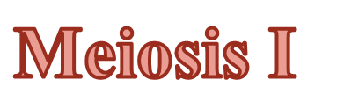
PROPHASE I
Prophase I is the longest in duration compared to Prophase in mitosis.
It takes about 85 - 95 percent of the total time for meiosis and also much more complex.
The Prophase I subdivided into 5 substages (Le Za Pa Di Dia):
  Leptotene
  Zygotene
  Pachytene
  Diplotene
  Diakinesis

Slide 24
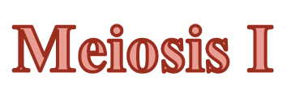
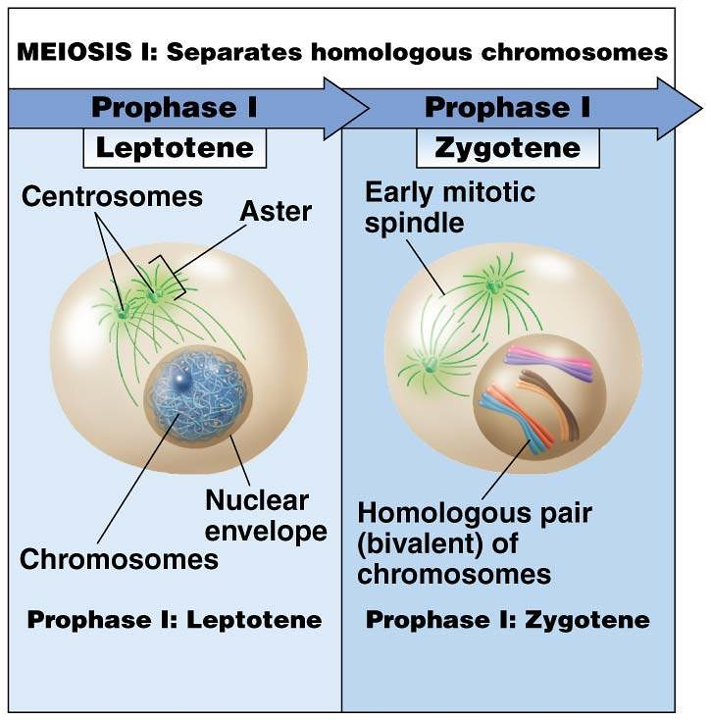
Prophase I
LEPTOTENE
The first stage of Prophase I is called Leptotene or leptonema.
All the chromosomes begin to condense, so, they become visible as fine thread.
  There is marked increase in the nuclear volume.
A process of 'homology search' which is essential to the initial pairing of homologs, begins during

Slide 25
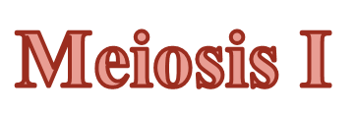
Prophase I
ZYGOTENE
The zygotene stage also known as zygonema.
This stage begins with the initiation of pairing between homologues chromosomes and it ends with complete pairing.
The process of pairing (at end to end) between homologues chromosomes is known as Synapsis (Homologous dyads)
The synaptonemal complex is form during these zygotene stage.
At the completion of zygotene, the paired homologs take the form of bivalents.
The number of bivalents in each species is equal to the haploid number.

Slide 26

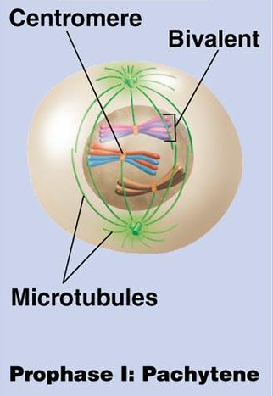
Prophase I
PACHYTENE
The pachytene stage also known as pachynema.
The process of synapsis is complete.
The two homologues of each bivalent appears to be attached with each other at one or more points, these attachments are known as chiasmata.
Tetrads are so tight that non-sister chromatids from the homologous pair actually exchange genetic material
Crossing over- The exchange of genetic material by non-sister chromatids

Slide 27
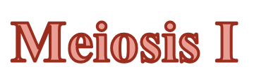
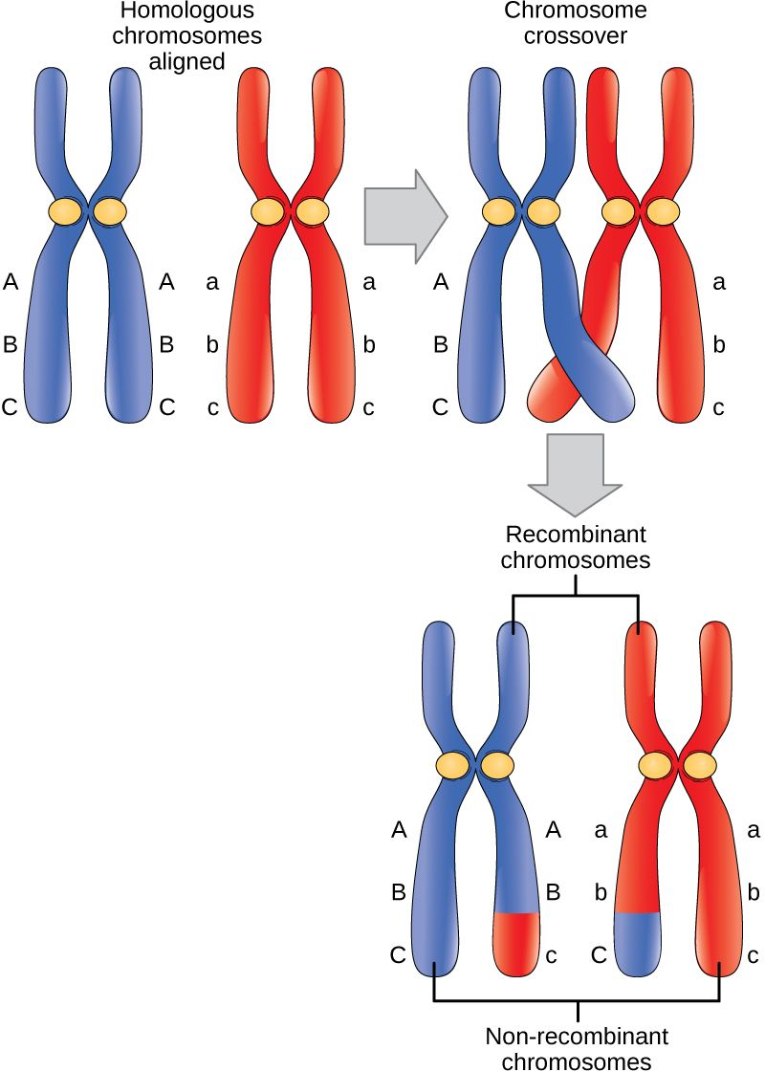
Prophase I
PACHYTENE
Crossing over is a precise breakage, swapping and reunion between two non-sister chromatids.
Crossovers make new gene combinations and which are an important source of genetic variations in populations.

Slide 28
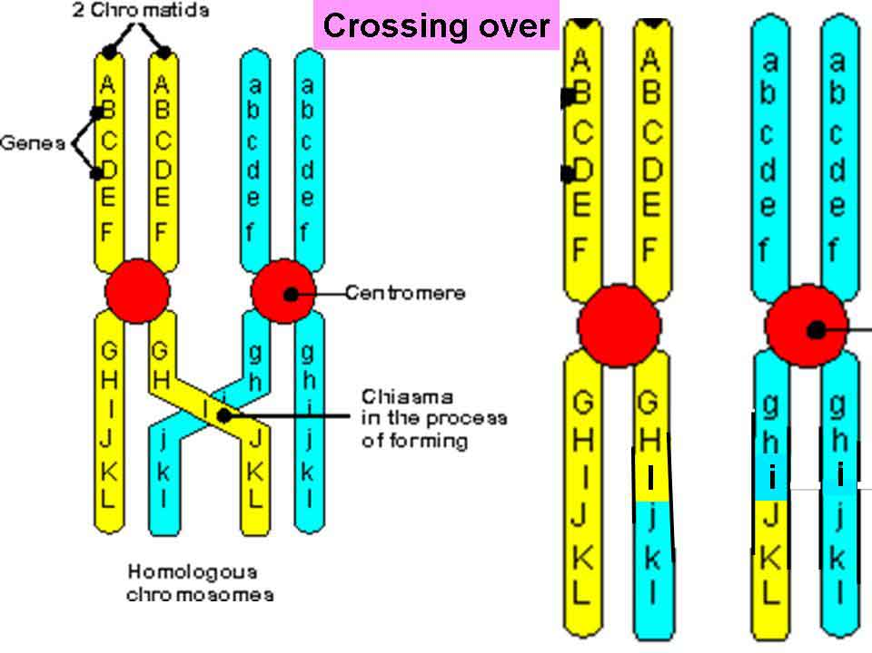

Slide 29
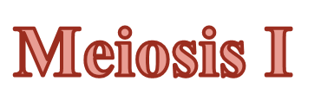
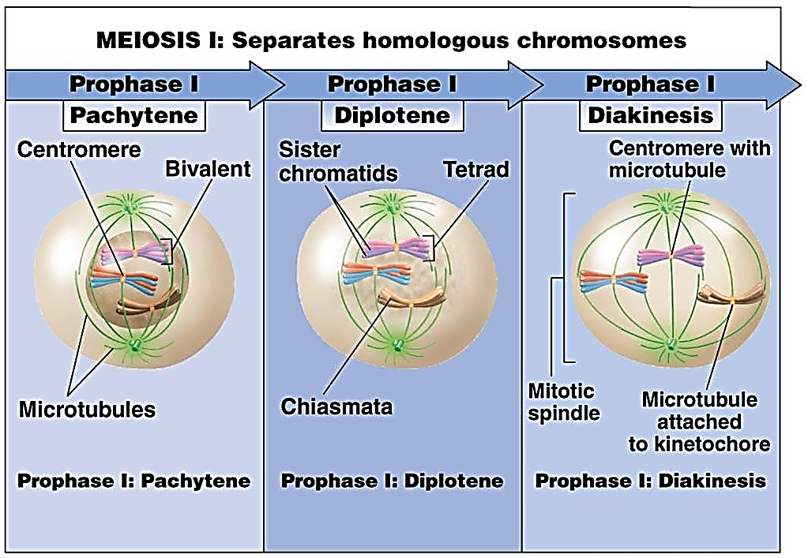
Prophase I
DIPLOTENE
The diplotene stage also known as diplonema.
DNA recombination is complete.
The chromatids continue to shorten and thicken and the four sister chromatids in a group is called a tetrad.
The synaptonemal complex begins to break down.
The paired chromatids begin to pull apart, causing the strands to separate longitudinally.
The chiasmata tend to become terminalized as the meiotic prophase continues.

Slide 30

Prophase I
DIAKINESIS
The chromosomes become shorter and thicker due to condensation.
Nucleolus and nuclear envelope disappear towards the end of diakinesis.
The spindle apparatus becomes organized.
The centrioles migrate away from one another.

Slide 31
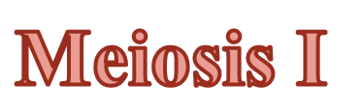
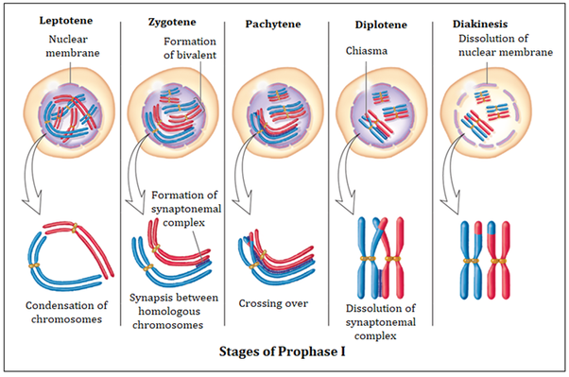

Slide 32
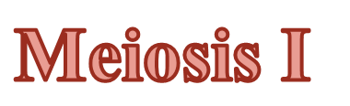
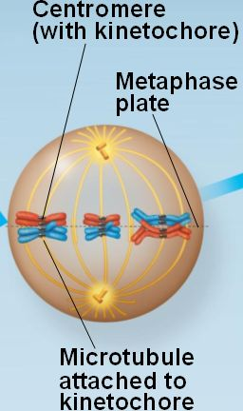
METAPHASE I
All the bivalents migrate within a cell migrate to metaphase plate.
One homologue is pulled above the metaphase plate, the other below.
The centromeres of homologous chromosomes of each bivalent stretch out on either side.
The centrioles are at opposite poles of the cell.
Spindle fibers from one pole of the cell attach to one chromosome and spindle fibers from the opposite pole attach to the homologous chromosome.

Slide 33
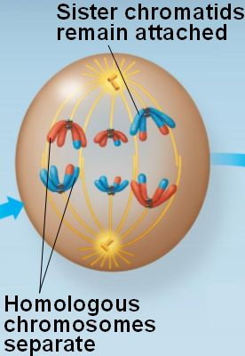
ANAPHASE I
Chromosomes move to the opposite poles.
The microtubules and the kinetochore fibers interact, which cause the movement.
A difference between mitosis and meiosis is that sister chromatids remain joined after metaphase in Meiosis I, whereas in mitosis they separate.
During Anaphase I original chromosomes separate, so reduction in the number of chromosomes from 2N to N number, yet the sister chromatids remain together.

Slide 34

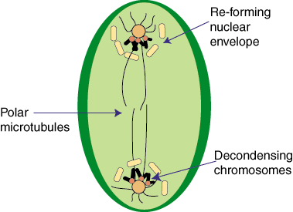
TELOPHASE I
The homologous chromosome complete their migration to the two poles b/c shortening of spindles.
The nuclear envelope organized around two groups of chromosomes.
The nucleolus also reappears.

Slide 35
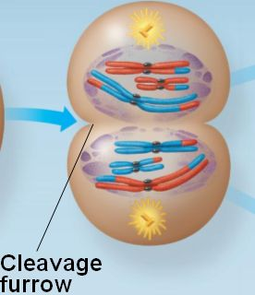
CYTOKINESIS
Cytokinesis involves the formation of a cleavage furrow, resulting in the pocketing of the cell into two cells.
At the end of Telophase I and Cytokinesis, two daughter cells are produced, each with one half of the number of chromosomes (haploid set of replicated chromosomes) of the original parent cell.

Slide 36
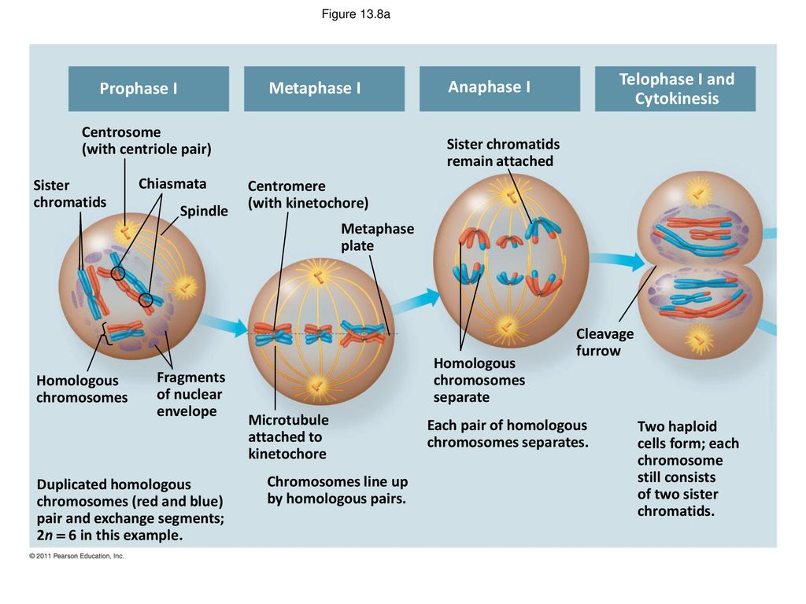
MEIOSIS I

Slide 37
INTERKINESIS
Interkinesis ( Interphase II ) is similar to interphase
After telophase I there maybe a short interphase, but not always.
It is important to note that if a cell does have a second interphase, there is No replication of chromosomes.

Slide 38
MEIOSIS II
Meiosis II is the second part of the meiotic process: Gamete formation
It is basically just like mitosis, but remember the chromosomes did not duplicate in interphase II.
Prophase II
  The chromosomes begin to condense accompanied by the dissolution of the nuclear membrane
  Chromosomes begin to line up in the middle of the cell.
  Spindle fibers begin to form
Metaphase II
  The chromosomes are connected to the centriole poles at the kinetochores of sister chromatids through the microtubules
  Chromosomes line up on the metaphase plate

Slide 39
MEIOSIS II
Anaphase II
  Centromeres split
  Sister chromatids separate and move to opposite sides of the cell
Telophase II
  Nuclei reform
  Spindle fibers disappear
  Followed by cytokinesis, telophase II marks the end of meiosis
  Four haploid daughter cells are formed as a result
  The number of chromosomes in each daughter cell has now been reduced by half

Slide 40
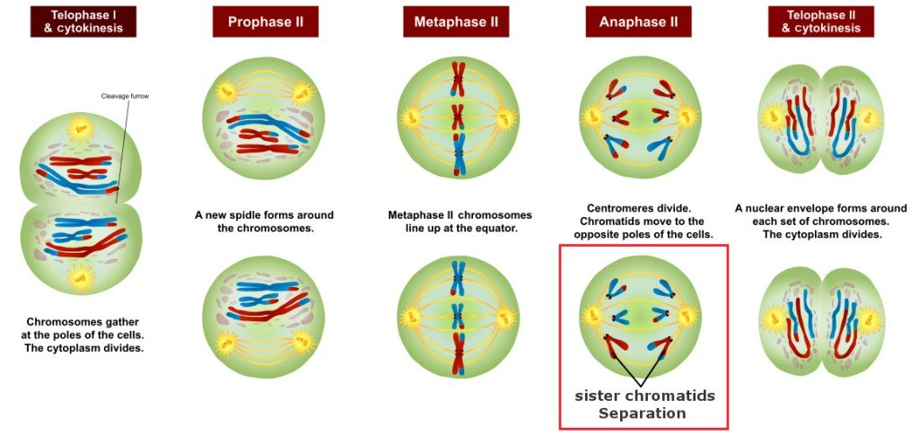
MEIOSIS II

Slide 41
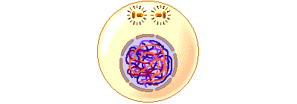
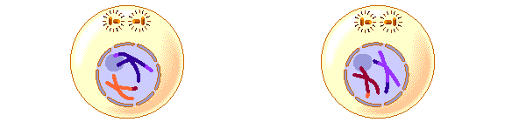
Meiosis I
Meiosis II
Slides
animated

Slide 42
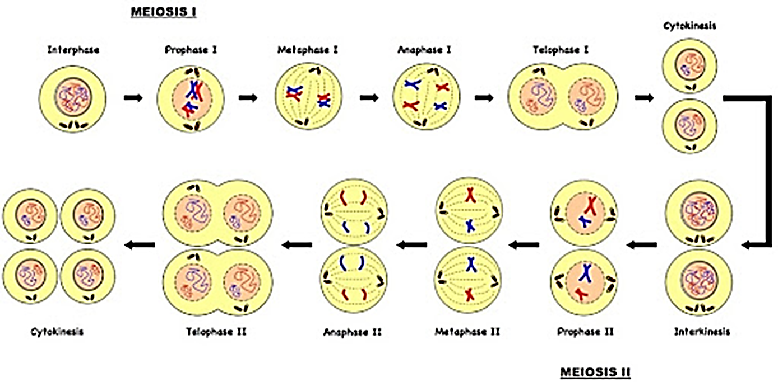

Slide 43
SIGNIFICANCE OF MEIOSIS
Reproduction in plants and animals takes place through the fusion of gametes.
If germ cells, which give rise to gametes, also maintains their ploidy during division like the somatic cells, the zygote will have an accumulation of chromosomes in its nucleus.
Meiosis offers a very smart solution to this problem as it reduces the number of chromosomes in the gametes to half of their parent germ cells.
Moreover, prophase I of meiosis allows recombination of homologous chromosomes.
This recombination is essential for the variation to be introduced in the genetic makeup of the gametes as this variation only holds the key to evolution through sexual reproduction.

Slide 44
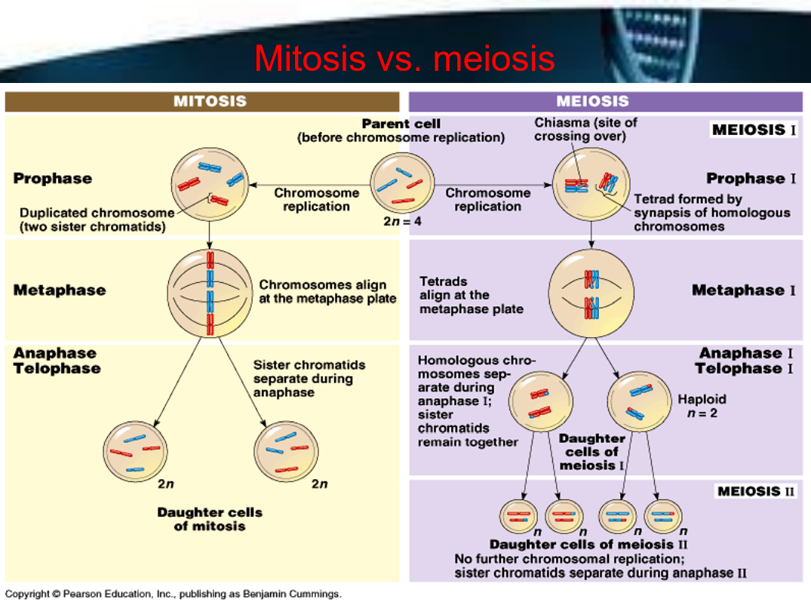

Slide 45
Differences between Mitosis and Meiosis
 | Mitosis | Meiosis
DIVISIONS
CHROMOSOME NUMBER
BIVALENTS
CHIASMATA
CROSSING OVER
DAUGHTER CELLS
NUMBER OF DAUGHTER CELLS
single division of chromosome and nucleus
single division of chromosome but double division of nucleus
remains the same (2n)
is halved (1n)
homologous chromosomes do not associate
homologous chromosomes associate to form bivalents in prophase I
never formed
may be formed
never occurs
may occur
identical to parent cells (in the absence of mutations)
genetically different from parent cells
two
four

Slide 46
Meiosis and Genetic Variation
Meiosis produces variation amongst offspring by:
  Crossing over during prophase I – new combinations of alleles are produced
  Independent assortment of homologous pairs at metaphase I and then again at metaphase II
  One way meiosis generates genetic variability is through the different ways in which maternal and paternal chromosomes are combined in the daughter cells
    The number of possible chromosome combinations in the haploid nuclei is potentially very large.
    In general, the number of possible chromosome combinations is 2n, where n is the number of chromosome pairs.
      For example, in fruit flies, which have 4 chromosome pairs, the number of possible combinations is 2n, or 16. For humans, with 23 chromosome pairs, there are over 8 million metaphase arrangements.

Slide 47
REFERENCES
C.B.Powar.2010 .Cell Biology VOL I. Himalaya Publishing House.
Robert Weaver. 2012 “Molecular Biology,” 5th Edition, MCGraw-Hill.
https://en.wikipedia.org/wiki/Cell_division#:~:text=Cell%20division%20is%20the%20process,of%20a%20larger%20cell%20cycle.
https://www.khanacademy.org/science/biology/cellular-molecular-biology
https://www.youtube.com/watch?v=NFdeXi9Gfpc
http://www.digimat.in/nptel/courses/video/121106008/L13.html
https://youtu.be/xsrH050wnIA

Slide 48

THANK YOU

